Slide 1


GLA UNIVERSITY MATHURA
Mini-project
Implementing web-Scraping in Python with BeautifulSoup
Group -25
Group Members :
Mentor :
Aditya Pratap Singh (191550006)
Dr. Subhash Chand Agrawal
Akash Kumar Jayas (191550007)
Avanish Singh (191550022)
Presented To :
Vishal Kumar (191550102)
Dr. Dhirendra Kumar Shukla

Slide 2
Web Scraping
Web Scraping is a technique to fetch data and information from websites.
Everything you see on a webpage can be scraped.
Can be done in most programming languages, we'll use Python.

Slide 3

Is Web Scraping illegal ?
Violation of the Computer Fraud and Abuse Act (CFAA)
Violation of the Digital Millennium Copyright Act (DMCA)
Trespass to Chattel
Copy right infringement
Breach of contract

Slide 4
Web crawling
A web crawler (also known as a web spider or web robot).
It is a program or automated script which browses the World Wide Web in a methodical, automated manner.
Crawlers can also be used for automating maintenance tasks on a Web site.
Such as checking links or validating HTML code.

Slide 5
Uses
Web Crawlers
E-Commerce price comparer
Preparing dataset for ML model
Scraping Social Media Profiles
Weather Data etc.

Slide 6
Purpose of project
Purpose of the project is to scrap data from flipcart mobile price list and store data in csv.
The data would be used for sentiment analysis.

Slide 7
Libraries, Workflow and Explanation
The project is basically divided into two parts :
(a) Scraping data from website.
(b) With the help of data sentiment analysis based on rating.

Slide 8


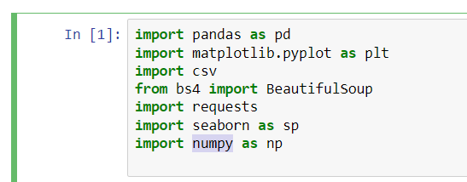

Scraping Data from Flipcart
Library used:
BeautifulSoup
requests
Csv
Pandas
matplotlib.pyplot
Seaborn
numpy

Slide 9

Csv lib:
CSV (Comma Separated Values) format is the most common import and export format for spreadsheets and databases.
In this project we used csv library for create spreadsheet which having fields or columns : name, price, rating, count_rating
So that their values get saved its respected fields
Create flipkart.csv file with written mode and provides fields

Slide 10
Requests lib:
Requests will allow you to send HTTP/1.1 requests using Python
In this project we request from flipkart link
Link or url is
https://www.flipkart.com/mobiles/pr?sid=tyy%2C4io&otracker=clp_metro_expandable_5_3.metroExpandable.METRO_EXPANDABLE_Shop%2BNow_mobile-phones-store_Q0QIS4SPJNLH_wp3&fm=neo%2Fmerchandising&iid=M_c59a68bf-abb0-414d-a5a1-c7cc6ccdb202_3.Q0QIS4SPJNLH&ppt=browse&ppn=browse&ssid=b3fqp623lc0000001638369228009&p%5B%5D=facets.brand%255B%255D%3DPOCO
Requesting:

Slide 11

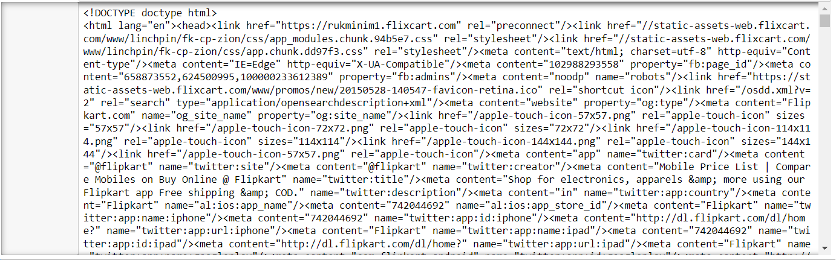
BeautifulSoup:
Beautiful Soup is a Python package used for parsing HTML .
In this project : we parsing the code by html.parser(it will extract all html code of webpage)
Code is :

Slide 12
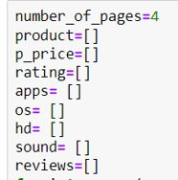
code
Numbers of pages you want to scraping in this we used 4 pages which contain 72 products. There are 8 empty lists are used for store their values likes: product list store mobile name or product name. P_price list store prices of products rating , sound ,hd, reviews lists store rating , battery details, hd quality, reviews respectively

Slide 13


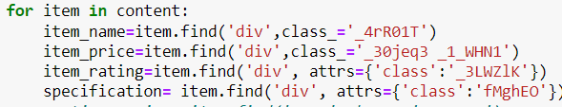
For each page we used for loop
Then we work on products division which contain all details of products we call them by using their class name _3pLy-c row
For each class of product we have to scraping to find details
For each product we scrap their name ,price , rating ,specification by using of their class name a each division of respected class we have same details for all products

Slide 14
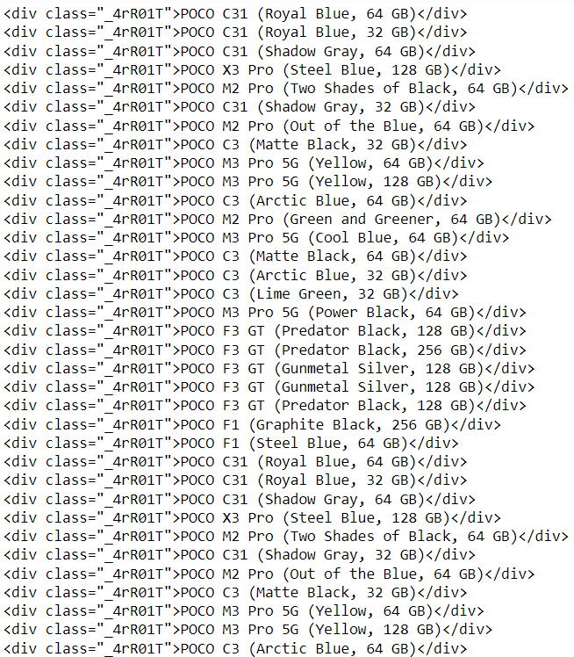
For item_name for div class name =“_4rR01T” contains names of products as shown

Slide 15
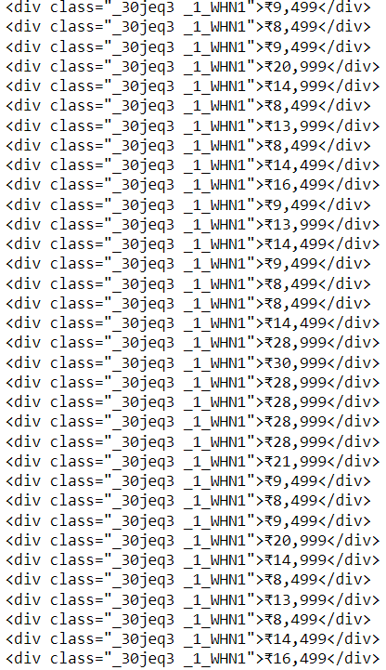
For item_price for div class name =“_30jeq3” contains names of products as shown

Slide 16
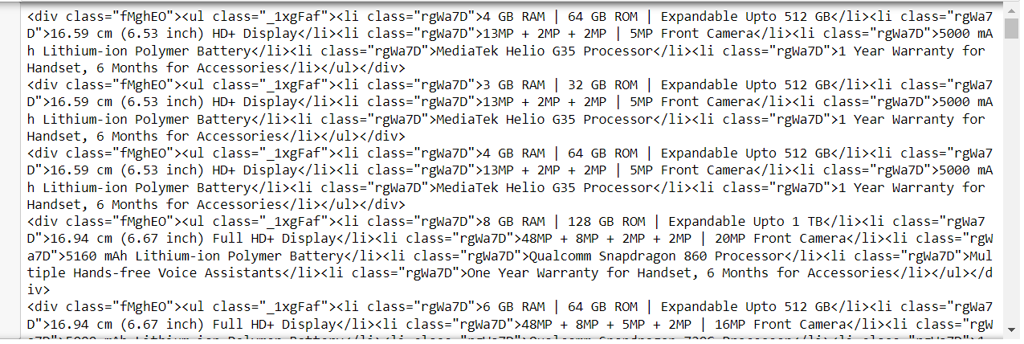
For specifications for div class name =“_1xgFaf” contains all details related to products
as shown

Slide 17
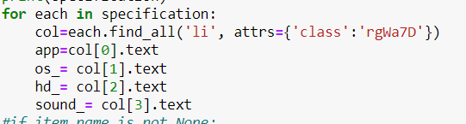
Extract details from specification division
Like :extract its sound details , its hd details , its os detail so one …

Slide 18
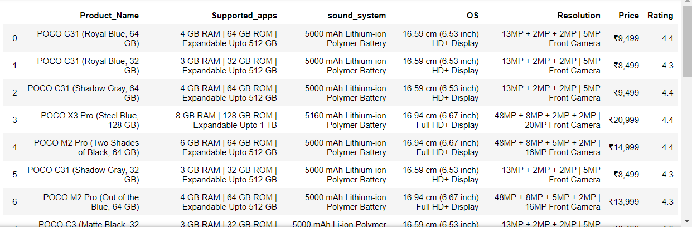
We made a dataframe that will store all values or details columns wise
Output :

Slide 19
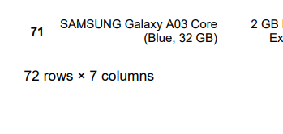
Totals Products in 4 pages are 72 and 7 columns
Now we got data and arrange them in csv file which contains all details related product

Slide 20

Sentiment Analysis

Slide 21
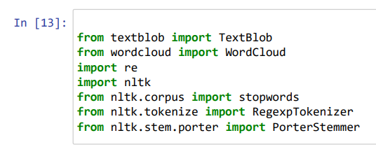
Library used:
TextBlob
WordCloud
re
nltk
Stopwords
RegexpTokenizer
PorterStemmer
matplot

Slide 22
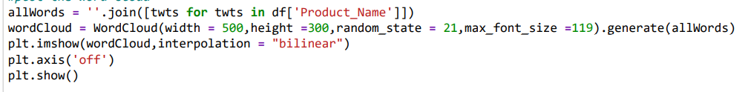
TextBlob and WordCloud
TextBlob is a Python library for processing textual data
Word Cloud is a data visualization technique used for representing text data in which the size of each word indicates its frequency or importance.
For plot word cloud we use code:
In this word get cloud for samsung mobile data

Slide 23
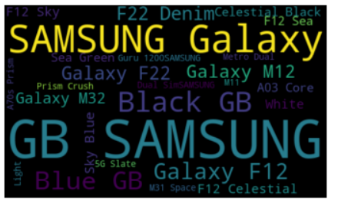
Output of wordcloud this image is plot using of matplotlib

Slide 24
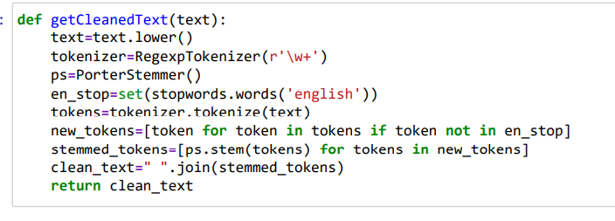
In this we a function which tokenize the word with respect to word +
And make pattern
for not take stop
Words
And clean the text
Return that all text

Slide 25
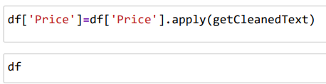
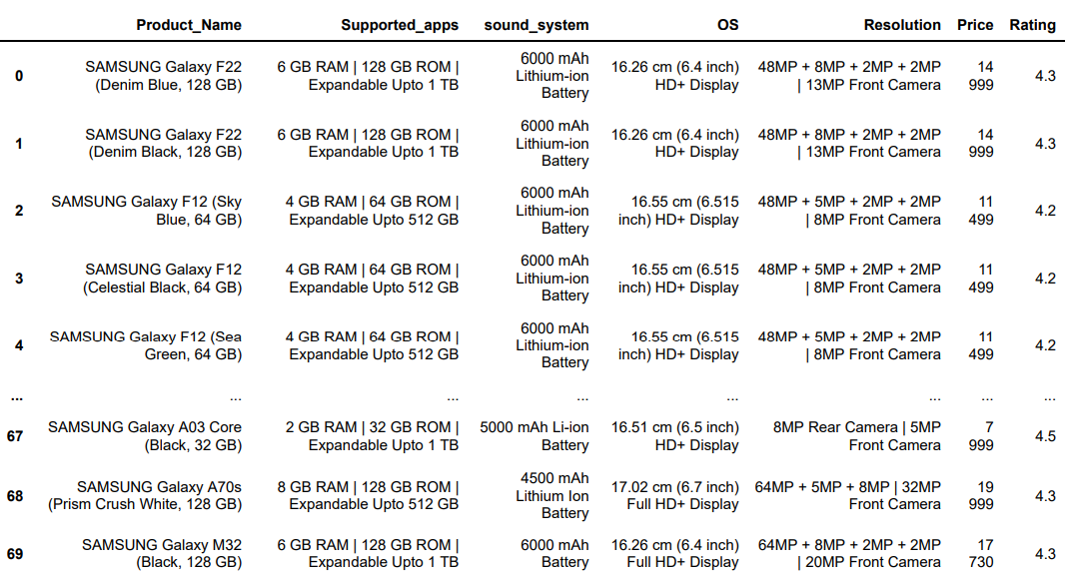
Apply clean text function in column

Slide 26
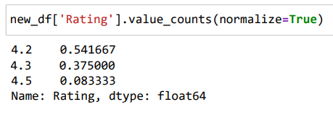
Then we normalized the rating value as true
As it show value for 4.2 rating we get normalize value of 0.541667
And similar to others

Slide 27
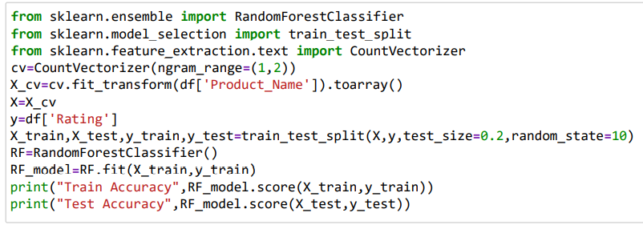

Now it turn of accuracy (for accuracy we design a model)

Slide 28

Thank you

